Slide 1
How C Code is Really Implemented

Slide 2
Overview
We program in C for convenience
There are no MCUs which execute C, only machine code
So we compile the C to assembly code, a human-readable representation of machine code
We need to know what the assembly code implementing the C looks like
To use the processor efficiently
To analyze the code with precision
To find performance and other problems
An overview of what C gets compiled to
C start-up module, subroutines calls, stacks, data classes and layout, pointers, control flow, etc.

Slide 3

Programmer’s World: The Land of Chocolate!
As many functions and variables as you want!
All the memory you could ask for!
So many data types! Integers, floating point,
So many data structures! Arrays, lists, trees, sets, dictionaries
So many control structures! Subroutines, if/then/else, loops, etc.
Iterators! Polymorphism!

Slide 4
Processor’s World
Data types
Integers
(More if you’re lucky!)
Instructions
Math: +, -, *
Logic: and, or
Shift, rotate
Move, swap
Compare
Jump, branch
23 | 251 | 151 | 11 | 3 | 1 | 1 | 1
213 | 6 | 234 | 2 | u | 1 | 1 | 1
2 | 33 | 72 | 1 | a | 1 | 1 | a
a | 4 | h | e | l | l | o | 1
67 | 96 | a | 0 | 9 | 9 | 9 | 1
6 | 11 | d | 72 | 7 | 0 | 0 | 0
28 | 289 | 37 | 54 | 42 | 0 | 0 | 0
213 | 6 | 234 | 2 | 31 | 1 | 1 | 1
Notes:
In contrast with the programmer’s view, the processor has a limited set of capabilities and treats most things as numbers. Parts of the software tool chain (the compiler and assembler) translate the program’s source code into object code which the processor can execute.

Slide 5
Program Translation Stages
Parser
reads in C code,
checks for syntax errors,
forms intermediate code (tree representation)
High-Level Optimizer
Modifies intermediate code (processor-independent)
Code Generator
Creates assembly code from of the intermediate code
Allocates variable uses to registers
Low-Level Optimizer
Modifies assembly code (parts are processor-specific)
Assembler
Creates object code (machine code)
Linker/Loader
Creates executable image from one or more object file
Compiler
Assembler
Linker/ Loader
Notes:
These three tools work in sequence to translate the program. We will focus on translation from source code to object code, which the compiler performs.

Slide 6
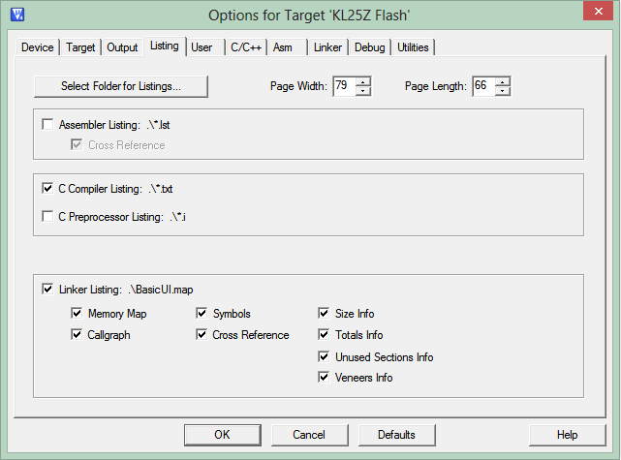
Examining Assembly Code before Debugger
Some compilers will generate assembly code listing for reference
MDK-Pro does, MDK-Lite does not
Select in project options
Notes:
We can ask the compiler to show us the assembly code which it has generated.

Slide 7
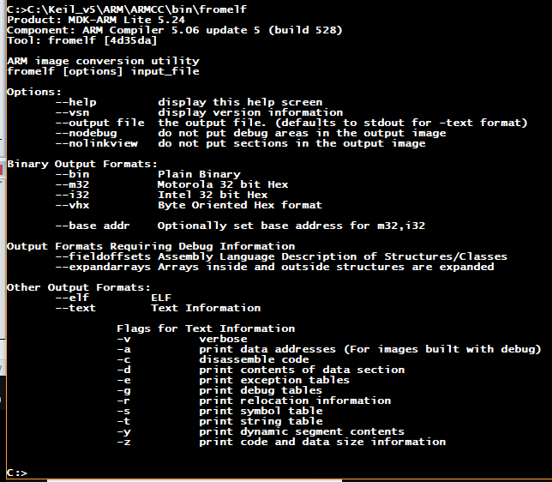
Disassemble Code from Command Prompt
Use fromelf.exe tool to disassemble ELF object code in .axf or .o file.
Located at \Keil_v5\ARM\ARMCC\bin
Specify text output with disassembled code
--text -c
Capture output in a text file
--output filename
> filename
\Keil_v5\ARM\ARMCC\bin\fromelf --text -c HBLED_Test.axf > HBLED_Test.dis
Could automate this in MDK after build completes
Notes:
We can ask the compiler to show us the assembly code which it has generated.

Slide 8
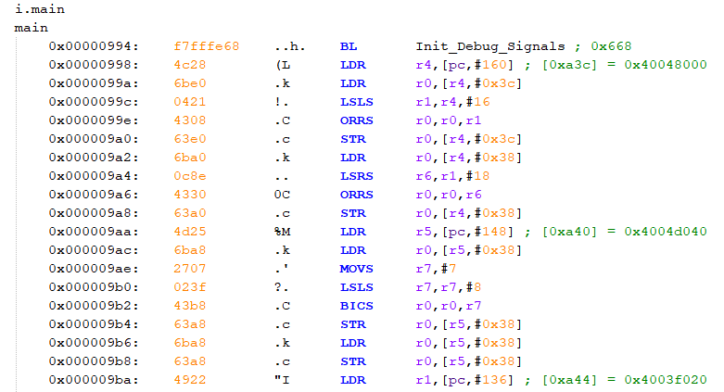
Example Output

Slide 9
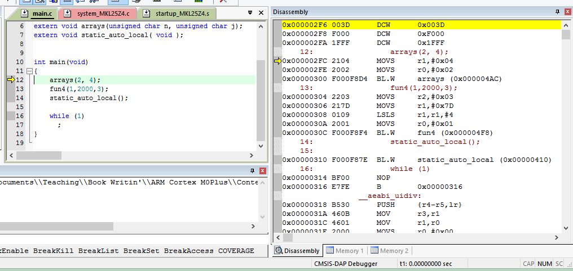
Examining Disassembled Program in Debugger
View->Disassembly Window
Notes:
We can also load the program into the debugger and examine the disassembled code.

Slide 10
A Warning About Code Optimizations
Compiler and rest of tool-chain try to optimize code:
Simplifying operations
Removing “dead” code
Using registers
These optimizations often get in way of understanding what the code does
Fundamental trade-off: Fast or comprehensible code?
Compilers typically offer a range of optimization levels (e.g. Level 0 to Level 3)
Code examples here may use “volatile” data type modifier to reduce compiler optimizations and improve readability

Slide 11
Application Binary Interface
ABI defines rules which allow functions developed separately to work together
ARM Architecture Procedure Call Standard (AAPCS)
Which registers must be saved and restored
How to call procedures
How to return from procedures
C Library ABI (CLIBABI)
C Library functions
Run-Time ABI (RTABI)
Run-time helper functions: 32/32 integer division, memory copying, floating-point operations, data type conversions, etc.
Notes:
The tools of the software development toolchain must follow certain rules to ensure that code developed separately can work together properly. There are several interface standards.

Slide 12
Memory requirements

Slide 13
What Memory Does a Program Need?
int a, b;
const char c=123;
int d=31;
void main(void) {
int e;
char f[32];
e = d + 7;
a = e + 29999;
strcpy(f,“Hello!”);
}
What does the memory hold?
Code
Read-only static data
Writable static data
Initialized
Zero-initialized
Uninitialized
Heap
Stack
What goes where?
Code is obvious
And the others?
Notes:
What kinds of memory are needed? This depends on how that data will be used.

Slide 14
What Memory Does a Program Need?
int a, b;
const char c=123;
int d=31;
void main(void) {
int e;
char f[32];
e = d + 7;
a = e + 29999;
strcpy(f,“Hello!”);
}
Can the information change?
No? Put it in read-only, nonvolatile memory
Instructions
Constant strings
Constant operands
Initialization values
Yes? Put it in read/write memory
Variables
Intermediate computations
Return address
Other housekeeping data
Notes:
Will the information change?

Slide 15
What Memory Does a Program Need?
int a, b;
const char c=123;
int d=31;
void main(void) {
int e;
char f[32];
e = d + 7;
a = e + 29999;
strcpy(f,“Hello!”);
}
How long does the data need to exist? Reuse memory if possible.
Statically allocated
Exists from program start to end
Each variable has its own fixed location
Space is not reused
Automatically allocated
Exists from function start to end
Space can be reused
Dynamically allocated
Exists from explicit allocation to explicit deallocation
Space can be reused
Notes:
How long does the data need to exist?

Slide 16
Program Memory Use
RAM
Flash ROM
Zero-Initialized Data
int a, b;
const char c=123;
int d=31;
void main(void) {
int e;
char f[32];
e = d + 7;
a = e + 29999;
strcpy(f,“Hello!”);
}
Constant Data
Initialized Data
InitializationData
Stack
Startup and Runtime Library Code
Heap Data
Program .text
Notes:
Here we see how different parts of the program lead to memory use in different sections of RAM and flash ROM.

Slide 17
Type and Class Qualifiers
Modify a variable’s declaration so compiler treats it differently
Const
Never written by program, can be put in ROM to save RAM
Volatile
Can be changed outside of normal program flow: ISR, hardware register
Compiler must be careful with optimizations
Static
Declared within function, retains value between function invocations
Scope is limited to function

Slide 18
Linker Map File
Contains extensive information on functions and variables
Value, type, size, object
Cross references between sections
Memory map of image
Sizes of image components
Summary of memory requirements

Slide 19
C Run-Time Start-Up Module
RAM
Flash ROM
After reset, MCU must…
Initialize hardware
Peripherals, etc.
Set up stack pointer
Initialize C or C++ run-time environment
Set up heap memory
Initialize variables
Zero-Initialized Data a, b
Fill with zeros
Initialization Data 31
Copy
Initialized Data d
Constant Data c: 123
Hello!
Stack e, f
Startup and Runtime Library Code
Heap Data
Code

Slide 20
Accessing data in Memory

Slide 21
Accessing Data
int siA;
void static_auto_local() {
int aiB;
static int siC=3;
int * apD;
int aiE=4, aiF=5, aiG=6;
siA = 2;
aiB = siC + siA;
apD = & aiB;
(*apD)++;
apD = &siC;
(*apD) += 9;
apD = &siA;
apD = &aiE;
apD = &aiF;
apD = &aiG;
(*apD)++;
aiE+=7;
*apD = aiE + aiF;
}
What does it take to get at a variable in memory?
Depends on location, which depends on storage type - static, automatic, or dynamic?

Slide 22
Static Variables – Fixed Address
Static var can be located anywhere in 32-bit memory space, so need a 32-bit pointer
Can’t fit a 32-bit pointer into a 16-bit instruction (or a 32-bit instruction), so save the pointer value separate from instruction but nearby
Load the pointer into a register (r0)
Can now load variable’s value into a register (r1) from memory using that pointer in r0
Similarly can store a new value to the variable in memory
Load r0 with pointer to variable
Load r1 from [r0]
Use value of variable
Label:
32-bit pointer to Variable
Variable

Slide 23
Static Variables
AREA ||.text||, CODE, READONLY, ALIGN=2
;;;20 siA = 2;
00000e 2102 MOVS r1,#2
000010 4a37 LDR r2,|L1.240|
000012 6011 STR r1,[r2,#0] ; siA
;;;21 aiB = siC + siA;
000014 4937 LDR r1,|L1.244|
000016 6809 LDR r1,[r1,#0] ; siC
000018 6812 LDR r2,[r2,#0] ; siA
00001a 1889 ADDS r1,r1,r2
...
|L1.240| DCD ||siA||
|L1.244| DCD ||siC||
AREA ||.data||, DATA, ALIGN=2
||siC|| DCD 0x00000003
||siA|| DCD 0x00000000
Key
variable’s value
variable’s address
address of copy of variable’s address
Code
Loads r2 with address of siA (from |L1.240|)
Loads r1 with contents of siA (via pointer r2, with offset 0)
Same for siC, with address at |L1.244|
Addresses of siA and siC are stored as literals to be loaded into pointers
Variables siC and siA are located in .data section with initial values

Slide 24
Automatic Variables Stored on Stack
Automatic variables are stored in a function’s activation record (unless optimized and promoted to register)
Activation records are located on the stack
Calling a function creates an activation record, allocating space on stack
Returning from a function deletes the activation record, freeing up space on stack
int main(void) {
auto vars
a();
}
void a(void) {
auto vars
b();
}
void b(void) {
auto vars
c();
}
void c(void) {
auto vars
…
}

Slide 25
Automatic Variables
int main(void) {
auto vars
a();
}
void a(void) {
auto vars
b();
}
void b(void) {
auto vars
c();
}
void c(void) {
auto vars
…
}
Lower address |  | (Free stack space)
 | Activation record for current function C | Local storage | <- Stack pointer while executing C
 |  | Saved regs
 |  | Arguments (optional)
 | Activation record for caller function B | Local storage | <- Stack pointer while executing B
 |  | Saved regs
 |  | Arguments (optional)
 | Activation record for caller’s caller function A | Local storage | <- Stack pointer while executing A
 |  | Saved regs
 |  | Arguments (optional)
Higher address | Activation record for caller’s caller’s caller function main | Local storage | <- Stack pointer while executing main
 |  | Saved regs
 |  | Arguments (optional)
Notes:
Function main calls function a, which calls function b, which calls function c. The call stack shows this nested call behavior.

Slide 26
Addressing Automatic Variables
Program must allocate space on stack for variables
Stack addressing uses an offset from the stack pointer: [sp, #offset]
One byte used for offset, is multiplied by four
Possible offsets: 0, 4, 8, …, 1020
Maximum range addressable this way is 1024 bytes
Address | Contents
SP
SP+4
SP+8
SP+0xC
SP+0x10
SP+0x14
SP+0x18
SP+0x1C
SP+0x20

Slide 27
Automatic Variables
Address | Contents
SP | aiG
SP+4 | aiF
SP+8 | aiE
SP+0xC | aiB
SP+0x10 | r0
SP+0x14 | r1
SP+0x18 | r2
SP+0x1C | r3
SP+0x20 | lr
;;;14 void static_auto_local( void ) {
000000 b50f PUSH {r0-r3,lr}
;;;15 int aiB;
;;;16 static int siC=3;
;;;17 int * apD;
;;;18 int aiE=4, aiF=5, aiG=6;
000002 2104 MOVS r1,#4
000004 9102 STR r1,[sp,#8]
000006 2105 MOVS r1,#5
000008 9101 STR r1,[sp,#4]
00000a 2106 MOVS r1,#6
00000c 9100 STR r1,[sp,#0]
…
;;;21 aiB = …
…
00001c 9103 STR r1,[sp,#0xc]
Initialize aiE
Initialize aiF
Initialize aiG
Store value for aiB

Slide 28
Using Pointers

Slide 29
Using Pointers to Automatics
C Pointer: a variable which holds the data’s address
aiB is on stack at SP+0xc
Compute r0 with variable’s address from stack pointer and offset (0xc)
Load r1 with variable’s value from memory
Operate on r1, save back to variable’s address
;;;22 apD = & aiB;
00001e a803 ADD r0,sp,#0xc
;;;23 (*apD)++;
000020 6801 LDR r1,[r0,#0]
000022 1c49 ADDS r1,r1,#1
000024 6001 STR r1,[r0,#0]

Slide 30
Using Pointers to Statics
Load r0 with variable’s address from address of copy of variable’s address
Load r1 with variable’s value from memory
Operate on r1, save back to variable’s address
;;;24 apD = &siC;
000026 4833 LDR r0,|L1.244|
;;;25 (*apD) += 9;
000028 6801 LDR r1,[r0,#0]
00002a 3109 ADDS r1,r1,#9
00002c 6001 STR r1,[r0,#0]
|L1.244|
DCD ||siC||
AREA ||.data||, DATA, ALIGN=2
||siC||
DCD 0x00000003

Slide 31
Array Access

Slide 32
Array Access
What does it take to get at an array element in memory?
Depends on how many dimensions
Depends on element size and row width
Depends on location, which depends on storage type (static, automatic, dynamic)
unsigned char buff2[3];
unsigned short int buff3[5][7];
unsigned int arrays(unsigned char n, unsigned char j) {
volatile unsigned int i;
i = buff2[0] + buff2[n];
i += buff3[n][j];
return i;
}

Slide 33
Accessing 1-D Array Elements
Need to calculate element address: sum of…
array start address
offset: index * element size
buff2 is array of unsigned characters
Move n (arg.) from r0 into r2
Load r3 with pointer to buff2
Load (byte) r3 with first element of buff2
Load r4 with pointer to buff2
Load (byte) r4 with element at address buff2+r2
r2 holds argument n
Add r3 and r4 to form sum
Address | Contents
buff2 | buff2[0]
buff2 + 1 | buff2[1]
buff2 + 2 | buff2[2]
4602 MOV r2,r0
;;;76 i = buff2[0] + buff2[n];
4b1b LDR r3,|L1.272|
781b LDRB r3,[r3,#0];buff2
4c1a LDR r4,|L1.272|
5ca4 LDRB r4,[r4,r2]
1918 ADDS r0,r3,r4
|L1.272|
DCD buff2

Slide 34
Accessing 2-D Array Elements
short int buff3[5][7]
var[rows][columns]
Sizes
Element: 2 bytes
Row: 7*2 bytes = 14 bytes (0xe)
Offset based on row index and column index
column offset = column index * element size
row offset = row index * row size
Address | Contents
buff3 | buff3[0][0]
buff3+1
buff3+2 | buff3[0][1]
buff3+3
(etc.)
buff3+10 | buff3[0][5]
buff3+11
buff3+12 | buff3[0][6]
buff3+13
buff3+14 | buff3[1][0]
buff3+15
buff3+16 | buff3[1][1]
buff3+17
buff3+18 | buff3[1][2]
buff3+19
(etc.)
buff3+68 | buff3[4][6]
buff3+69

Slide 35
Code to Access 2-D Array
Load r3 with row size
Multiply by row number (n, r2) to put row offset in r3
Load r4 with address of buff3
Add buff 3 address to row offset in r3
Shift column number (j, r1) left by one, multiplying by 2 (bytes/element)
Load (halfword) r3 with element at address r3+r4 (buff3 + row offset + col. offset)
Add r3 into variable i (r0)
;;;77 i += buff3[n][j];
0000aa 230e MOVS r3,#0xe
0000ac 4353 MULS r3,r2,r3
0000ae 4c19 LDR r4,|L1.276|
0000b0 191b ADDS r3,r3,r4
0000b2 004c LSLS r4,r1,#1
0000b4 5b1b LDRH r3,[r3,r4]
0000b6 1818 ADDS r0,r3,r0
|L1.276|
DCD buff3

Slide 36
Function Call Stack

Slide 37
Stack and Activation Records
Activation records are located on the stack
Calling a function creates an activation record
Returning from a function deletes the activation record
Automatic variables and housekeeping information are stored in a function’s activation record
Not all fields (LS, RA, Arg) may be present for each activation record
Lower address |  | (Free stack space)
 | Activation record for current function | Local storage | <- Stack ptr
 |  | Return address
 |  | Arguments
Higher address | Activation record for caller function | Local storage
 |  | Return address
 |  | Arguments

Slide 38
Main before Calling function a
int main(void) {
auto vars
a();
}
void a(void) {
auto vars
b();
}
void b(void) {
auto vars
c();
}
void c(void) {
auto vars
…
}
main
Lower address |  | (Free stack space)
Higher address | Activation record for main | Local storage | <- Stack pointer while executing main
 |  | Saved regs
 |  | Arguments (optional)
Notes:
Function main calls function a, which calls function b, which calls function c. The call stack shows this nested call behavior.

Slide 39
Function a before calling function b
int main(void) {
auto vars
a();
}
void a(void) {
auto vars
b();
}
void b(void) {
auto vars
c();
}
void c(void) {
auto vars
…
}
main
Lower address |  | (Free stack space)
 | Activation record for function a | Local storage | <- Stack pointer while executing a
 |  | Saved regs
 |  | Arguments (optional)
Higher address | Activation record for main | Local storage | <- Stack pointer while executing main
 |  | Saved regs
 |  | Arguments (optional)
a
Notes:
Function main calls function a, which calls function b, which calls function c. The call stack shows this nested call behavior.

Slide 40
Function b before calling function c
int main(void) {
auto vars
a();
}
void a(void) {
auto vars
b();
}
void b(void) {
auto vars
c();
}
void c(void) {
auto vars
…
}
main
Lower address |  | (Free stack space)
 | Activation record for function b | Local storage | <- Stack pointer while executing b
 |  | Saved regs
 |  | Arguments (optional)
 | Activation record for function A | Local storage | <- Stack pointer while executing a
 |  | Saved regs
 |  | Arguments (optional)
Higher address | Activation record for function main | Local storage | <- Stack pointer while executing main
 |  | Saved regs
 |  | Arguments (optional)
a
b
Notes:
Function main calls function a, which calls function b, which calls function c. The call stack shows this nested call behavior.

Slide 41
Function c
int main(void) {
auto vars
a();
}
void a(void) {
auto vars
b();
}
void b(void) {
auto vars
c();
}
void c(void) {
auto vars
…
}
main
Lower address |  | (Free stack space)
 | Activation record for current function C | Local storage | <- Stack pointer while executing C
 |  | Saved regs
 |  | Arguments (optional)
 | Activation record for caller function B | Local storage | <- Stack pointer while executing B
 |  | Saved regs
 |  | Arguments (optional)
 | Activation record for caller’s caller function A | Local storage | <- Stack pointer while executing A
 |  | Saved regs
 |  | Arguments (optional)
Higher address | Activation record for caller’s caller’s caller function main | Local storage | <- Stack pointer while executing main
 |  | Saved regs
 |  | Arguments (optional)
a
b
c
Notes:
Function main calls function a, which calls function b, which calls function c. The call stack shows this nested call behavior.

Slide 42
Function b after calling function c
int main(void) {
auto vars
a();
}
void a(void) {
auto vars
b();
}
void b(void) {
auto vars
c();
}
void c(void) {
auto vars
…
}
main
Lower address |  | (Free stack space)
 | Activation record for function b | Local storage | <- Stack pointer while executing b
 |  | Saved regs
 |  | Arguments (optional)
 | Activation record for function A | Local storage | <- Stack pointer while executing a
 |  | Saved regs
 |  | Arguments (optional)
Higher address | Activation record for function main | Local storage | <- Stack pointer while executing main
 |  | Saved regs
 |  | Arguments (optional)
a
b
Notes:
Function main calls function a, which calls function b, which calls function c. The call stack shows this nested call behavior.

Slide 43
Function a after calling function b
int main(void) {
auto vars
a();
}
void a(void) {
auto vars
b();
}
void b(void) {
auto vars
c();
}
void c(void) {
auto vars
…
}
main
Lower address |  | (Free stack space)
 | Activation record for function a | Local storage | <- Stack pointer while executing a
 |  | Saved regs
 |  | Arguments (optional)
Higher address | Activation record for main | Local storage | <- Stack pointer while executing main
 |  | Saved regs
 |  | Arguments (optional)
a
Notes:
Function main calls function a, which calls function b, which calls function c. The call stack shows this nested call behavior.

Slide 44
Main after calling function a
int main(void) {
auto vars
a();
}
void a(void) {
auto vars
b();
}
void b(void) {
auto vars
c();
}
void c(void) {
auto vars
…
}
main
Lower address |  | (Free stack space)
Higher address | Activation record for main | Local storage | <- Stack pointer while executing main
 |  | Saved regs
 |  | Arguments (optional)
Notes:
Function main calls function a, which calls function b, which calls function c. The call stack shows this nested call behavior.

Slide 45
Summary of Stack Memory Use
main
32 bytes
Stack grows with calls to subroutines (and ISRs), shrinks with returns
Depth in callgraph determines amount of stack space used
Maximum stack space required at leaf nodes (c) of call graph
a
4 bytes
b
8 bytes
c
20 bytes
64
44 |  |  |  | c
36 |  |  | b | b | b
32 |  | a | a | a | a | a
0 | main | main | main | main | main | main | main
Maximum stack space needed (ignoring ISRs)

Slide 46
Example of Recursion
Lower address |  | (Free stack space)
 | Activation record for current function a | Local storage | <- Stack pointer while executing a
 |  | Saved regs
 |  | Arguments (optional)
 | Activation record for caller function a | Local storage | <- Stack pointer while executing a
 |  | Saved regs
 |  | Arguments (optional)
 | Activation record for caller’s caller function a | Local storage | <- Stack pointer while executing a
 |  | Saved regs
 |  | Arguments (optional)
Higher address | Activation record for caller’s caller’s caller function main | Local storage | <- Stack pointer while executing main
 |  | Saved regs
 |  | Arguments (optional)
int main(void) {
auto vars
a();
}
main
a
void a(void) {
auto vars
a();
}
a
a
Notes:
Function main calls function a, which calls function b, which calls function c. The call stack shows this nested call behavior.

Slide 47
Calling Functions

Slide 48
Function Arguments and Return Values
First, pass the arguments
How to pass them?
Much faster to use registers than stack
But quantity of registers is limited
Basic rules
Process arguments in order they appear in source code
Round size up to be a multiple of 4 bytes
Copy arguments into core registers (r0-r3), aligning doubles to even registers
Copy remaining arguments onto stack, aligning doubles to even addresses
Specific rules in AAPCS, Section 5.5
Second, call the function
Usually as subroutine with branch link (bl) or branch link and exchange instruction (blx)
Exceptions in AAPCS

Slide 49
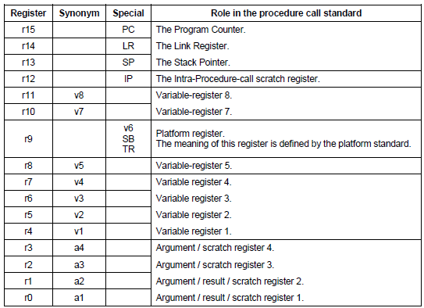
AAPCS Core Register Use
Notes:
Registers r0 through r3 are used to pass arguments.

Slide 50
Return Values
Callee passes Return Value in register(s) or stack
Registers: r0, r0-r1, or r0-r3
Stack
Caller function allocates space on stack for return value, then passes pointer to space as an argument to callee
Callee stores result at location indicated by pointer
Example: a’s result is passed on stack
Return value size | Registers used for passing
 | Fundamental Data Type | Composite Data Type
1-4 bytes | r0 | r0
8 bytes | r0-r1 | stack
16 bytes | r0-r3 | stack
Indeterminate size | n/a | stack
int main(…) {
a(…);
c(…);
}
big_return_type a(…){
b(…);
}
small_return_type b(…) {
}
small_return_type c(…) {
}
 |  |  |  | b
 |  |  | a
 |  | space for a’s return value |  |  |  |  |  | c
 | main

Slide 51
Call Example: Calling Function
int fun2(int arg2_1, int arg2_2) {
int i;
arg2_2 += fun3(arg2_1, 4, 5, 6);
…
}
fun2 PROC
;;;85 int fun2(int arg2_1, int arg2_2) {
...
0000e0 2306 MOVS r3,#6
0000e2 2205 MOVS r2,#5
0000e4 2104 MOVS r1,#4
0000e6 4630 MOV r0,r6
0000e8 f7fffffe BL fun3
0000ec 1904 ADDS r4,r0,r4
Argument 4 into r3
Argument 3 into r2
Argument 2 into r1
Argument 1 into r0
Call fun3 with BL instruction
Result was returned in r0, so add to r4 (arg2_2 += result)
Notes:
Let’s look at an example of how a function (fun2) calls another (fun3) and uses its return value. First the arguments are copied into r0 – r3, and then fun3 is called. After it returns, the result is in r0.

Slide 52
Call and Return Example
int fun3(int arg3_1, int arg3_2,
int arg3_3, int arg3_4) {
return arg3_1*arg3_2*
arg3_3*arg3_4;
}
fun3 PROC
;;;81 int fun3(int arg3_1, int arg3_2, int arg3_3, int arg3_4) {
0000ba b510 PUSH {r4,lr}
0000c0 4348 MULS r0,r1,r0
0000c2 4350 MULS r0,r2,r0
0000c4 4358 MULS r0,r3,r0
0000c6 bd10 POP {r4,pc}
Save r4 and Link Register on stack
r0 = arg3_1*arg3_2
r0 *= arg3_3
r0 *= arg3_4
Restore r4 and return from subroutine
Return value is in r0
Notes:
Here we see how function fun3 uses the arguments and returns the result (the product of the arguments).

Slide 53
Function Prolog and Epilog

Slide 54
Prolog and Epilog
A function’s P&E are responsible for creating and destroying its activation record
Remember the AAPCS
Scratch registers r0-r3 are not expected to be preserved upon returning from a called subroutine, can be overwritten
Preserved (“variable”) registers r4-r8, r10-r11 must have their original values upon returning from a called subroutine
Prolog
Save preserved registers on stack
May handle function arguments
May allocate temporary storage space on stack (subtract from SP)
Epilog
Restore preserved registers from stack
May deallocate stack space (add to SP)
May handle function return value
Returns control to calling function

Slide 55
Return Address
Return address stored in LR by bl, blx instructions
Consider case where a() calls b() which calls c()
On entry to b(), LR holds return address in a()
When b() calls c(), LR will be overwritten with return address in b()
After c() returns, b() will have lost its return address
Does this function call a subroutine?
Yes: must save and restore LR on stack just like other preserved registers, but LR value is popped into PC rather than LR
No: don’t need to save or restore LR, as it will not be modified

Slide 56
Function Prolog and Epilog
fun4 PROC
;;;102 int fun4(char a, int b, char c) {
;;;103 volatile int x[8];
00010a b510 PUSH {r4,lr}
00010c b088 SUB sp,sp,#0x20
...
;;;106 return a+b+c;
00011c 1858 ADDS r0,r3,r1
00011e 1880 ADDS r0,r0,r2
;;;107 }
000120 b008 ADD sp,sp,#0x20
000122 bd10 POP {r4,pc}
ENDP
Save r4 (preserved register) and link register (return address)
Allocate 32 (0x20) bytes on stack for array x by subtracting from SP
Compute return value, placing in return register r0
Deallocate 32 bytes from stack
Pop r4 (preserved register) and PC (return address)

Slide 57
Activation Record Creation by Prolog
Smaller address | space for x[0] | Array x | <- 3. SP after sub sp,sp,#0x20
 | space for x[1]
 | space for x[2]
 | space for x[3]
 | space for x[4]
 | space for x[5]
 | space for x[6]
 | space for x[7]
 | lr | Return address | <- 2. SP after push {r4,lr}
 | r4 | Preserved register
Larger address |  | Caller’s stack frame | <- 1. SP on entry to function, before push {r4,lr}
Notes:
Stack grows as space is used or allocated in steps 2 and 3.

Slide 58
Activation Record Destruction by Epilog
Smaller address | space for x[0] | Array x | <- 1. SP before add sp,sp,#0x20
 | space for x[1]
 | space for x[2]
 | space for x[3]
 | space for x[4]
 | space for x[5]
 | space for x[6]
 | space for x[7]
 | lr | Return address | <- 2. SP after add sp,sp,#20
 | r4 | Preserved register
Larger address |  | Caller’s stack frame | <- 3. SP after pop {r4,pc}
Notes:
Stack shrinks as space is released in steps 2 and 3.

Slide 59
Control Flow

Slide 60
Control Flow: Conditionals and Loops
if (x){
y++;
} else {
y--;
}
switch (x) {
case 1:
y += 3;
break;
case 31:
y -= 5;
break;
default:
y--;
break;
}
while (x<10) {
x = x + 1;
}
for (i = 0; i < 10; i++){
x += i;
}
do {
x += 2;
} while (x < 20);
How does the compiler implement conditionals and loops?

Slide 61
Control Flow: If/Else
;;;39 if (x){
000056 2900 CMP r1,#0
000058 d001 BEQ |L1.94|
;;;40 y++;
00005a 1c52 ADDS r2,r2,#1
00005c e000 B |L1.96|
|L1.94|
;;;41 } else {
;;;42 y--;
00005e 1e52 SUBS r2,r2,#1
|L1.96|
;;;43 }
if (x){
y++;
} else {
y--;
}
Notes:
The BEQ instruction will cause the program to jump to the code at |L1.94| if the variable x is zero. Otherwise the branch will not be taken, and the

Slide 62
Control Flow: Switch
;;;45 switch (x) {
000060 2901 CMP r1,#1
000062 d002 BEQ |L1.106|
000064 291f CMP r1,#0x1f
000066 d104 BNE |L1.114|
000068 e001 B |L1.110|
|L1.106|
;;;46 case 1:
;;;47 y += 3;
00006a 1cd2 ADDS r2,r2,#3
;;;48 break;
00006c e003 B |L1.118|
|L1.110|
;;;49 case 31:
;;;50 y -= 5;
00006e 1f52 SUBS r2,r2,#5
;;;51 break;
000070 e001 B |L1.118|
|L1.114|
;;;52 default:
;;;53 y--;
000072 1e52 SUBS r2,r2,#1
;;;54 break;
000074 bf00 NOP
|L1.118|
000076 bf00 NOP
;;;55 }
Notes:
The compiler may generate code for a switch statement in one of several ways. One approach is to sequentially test each possible case value, as shown here with instructions at addresses 60 and 64. Other approaches are using a computed jump or a jump table.

Slide 63
Iteration: While
;;;57 while (x<10) {
000078 e000 B |L1.124|
|L1.122|
;;;58 x = x + 1;
00007a 1c49 ADDS r1,r1,#1
|L1.124|
00007c 290a CMP r1,#0xa ;57
00007e d3fc BCC |L1.122|
;;;59 }
Notes:
This is a top-test loop.

Slide 64
Iteration: For
;;;61 for (i = 0; i < 10; i++){
000080 2300 MOVS r3,#0
000082 e001 B |L1.136|
|L1.132|
;;;62 x += i;
000084 18c9 ADDS r1,r1,r3
000086 1c5b ADDS r3,r3,#1 ;61
|L1.136|
000088 2b0a CMP r3,#0xa
;61
00008a d3fb BCC |L1.132|
;;;63 }

Slide 65
Iteration: Do/While
;;;65 do {
00008c bf00 NOP
|L1.142|
;;;66 x += 2;
00008e 1c89 ADDS r1,r1,#2
;;;67 } while (x < 20);
000090 2914 CMP r1,#0x14
000092 d3fc BCC |L1.142|
Notes:
This is a bottom-test loop.

